Slide 1
How TikTok Revolutionize The Social Media World Presented By : Alan Yeh

Slide 2
History Of TikTok Parent Company : ByteDance Launched in Sept’2016 in China under the name Douyin 抖音 Make a variety of short-form videos like dance, comedy , education that hve duration of 3 – 60 seconds In 2017, TikTok was launched outside China Market Acquired Musical.ly in 2018 and leveraging Musical.ly’s existing user base

Slide 3
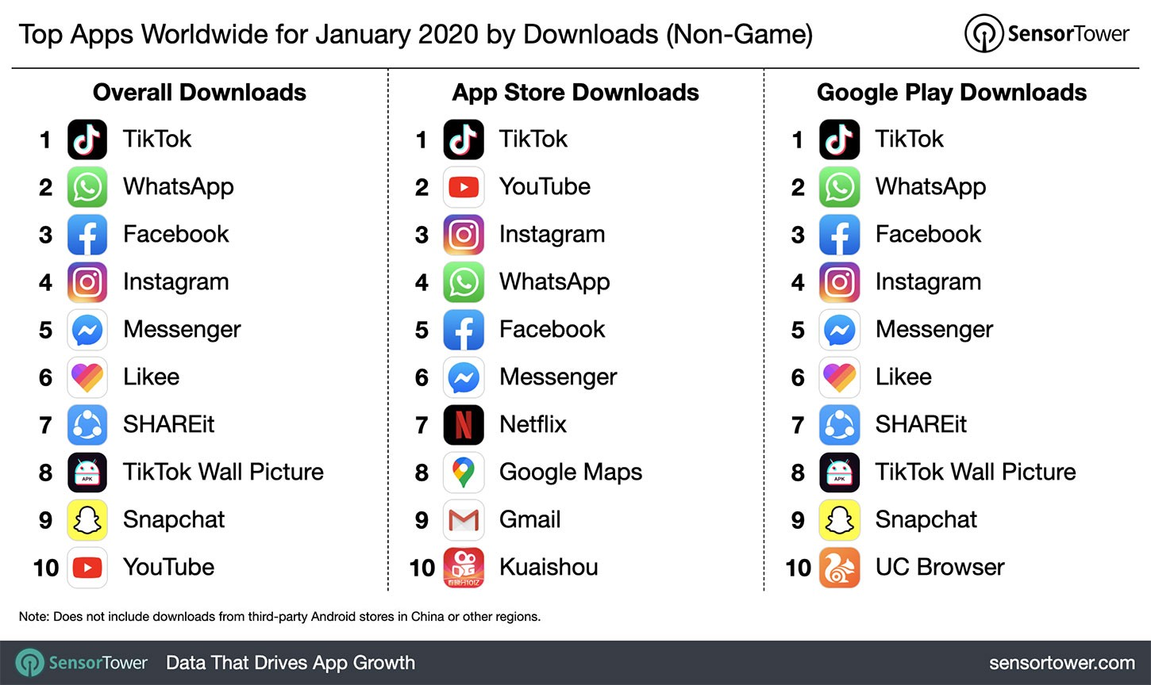
TikTok’s unprecedented success story Achieve 800 million active monthly users in 2020 TikTok videos tagged with #coronavirus have been watched 53 Bil times

Slide 4
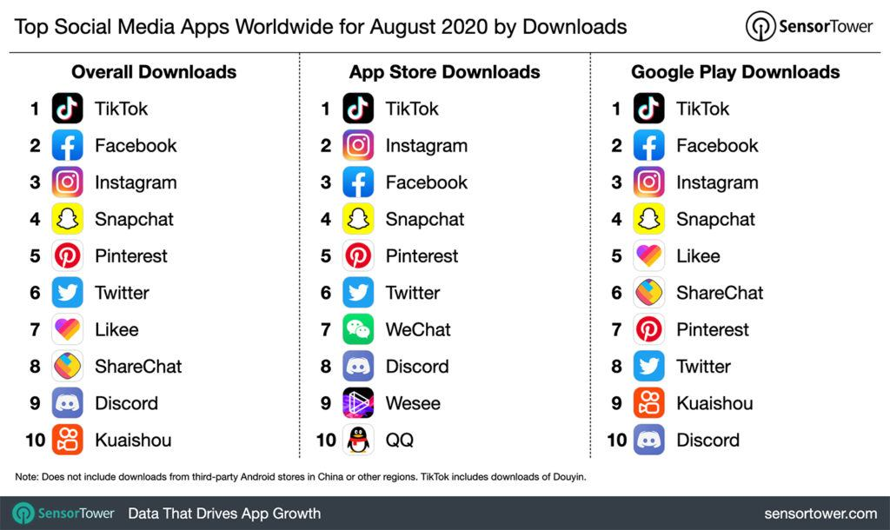
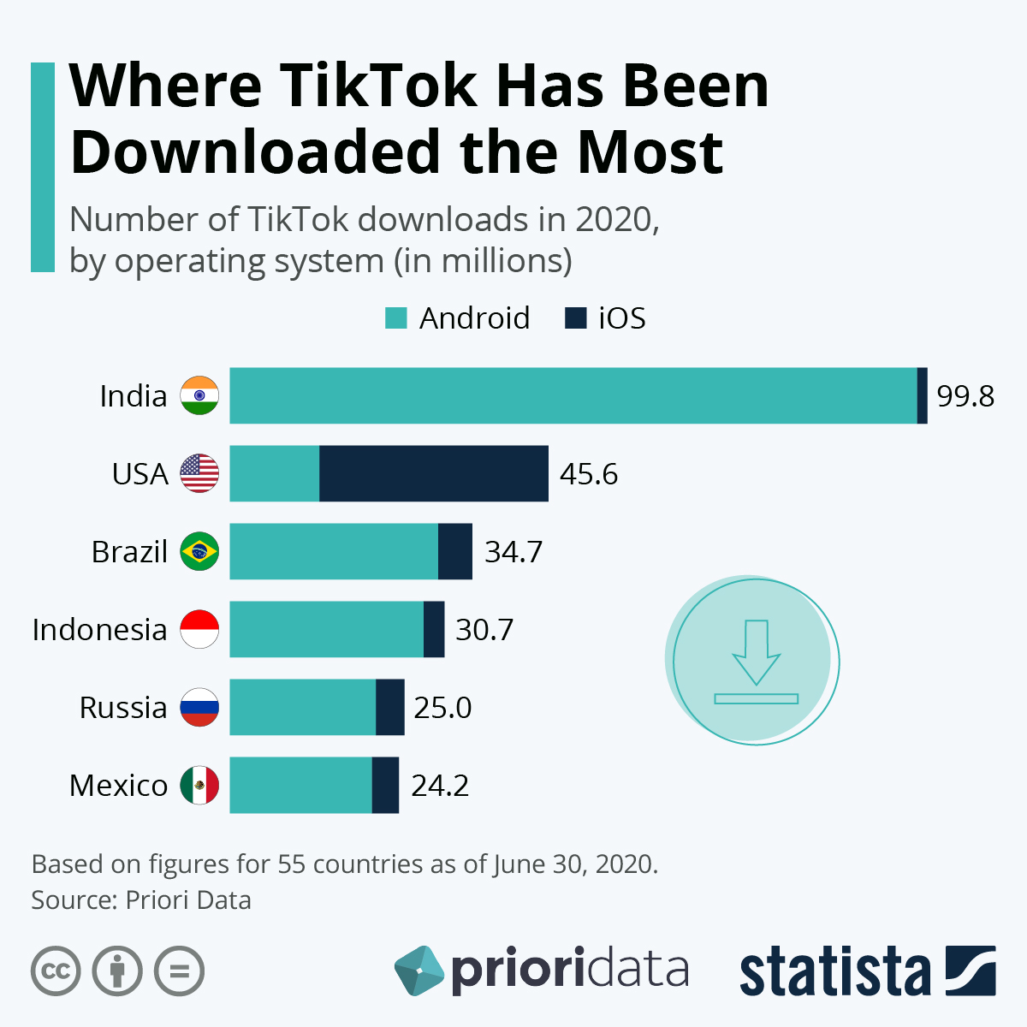
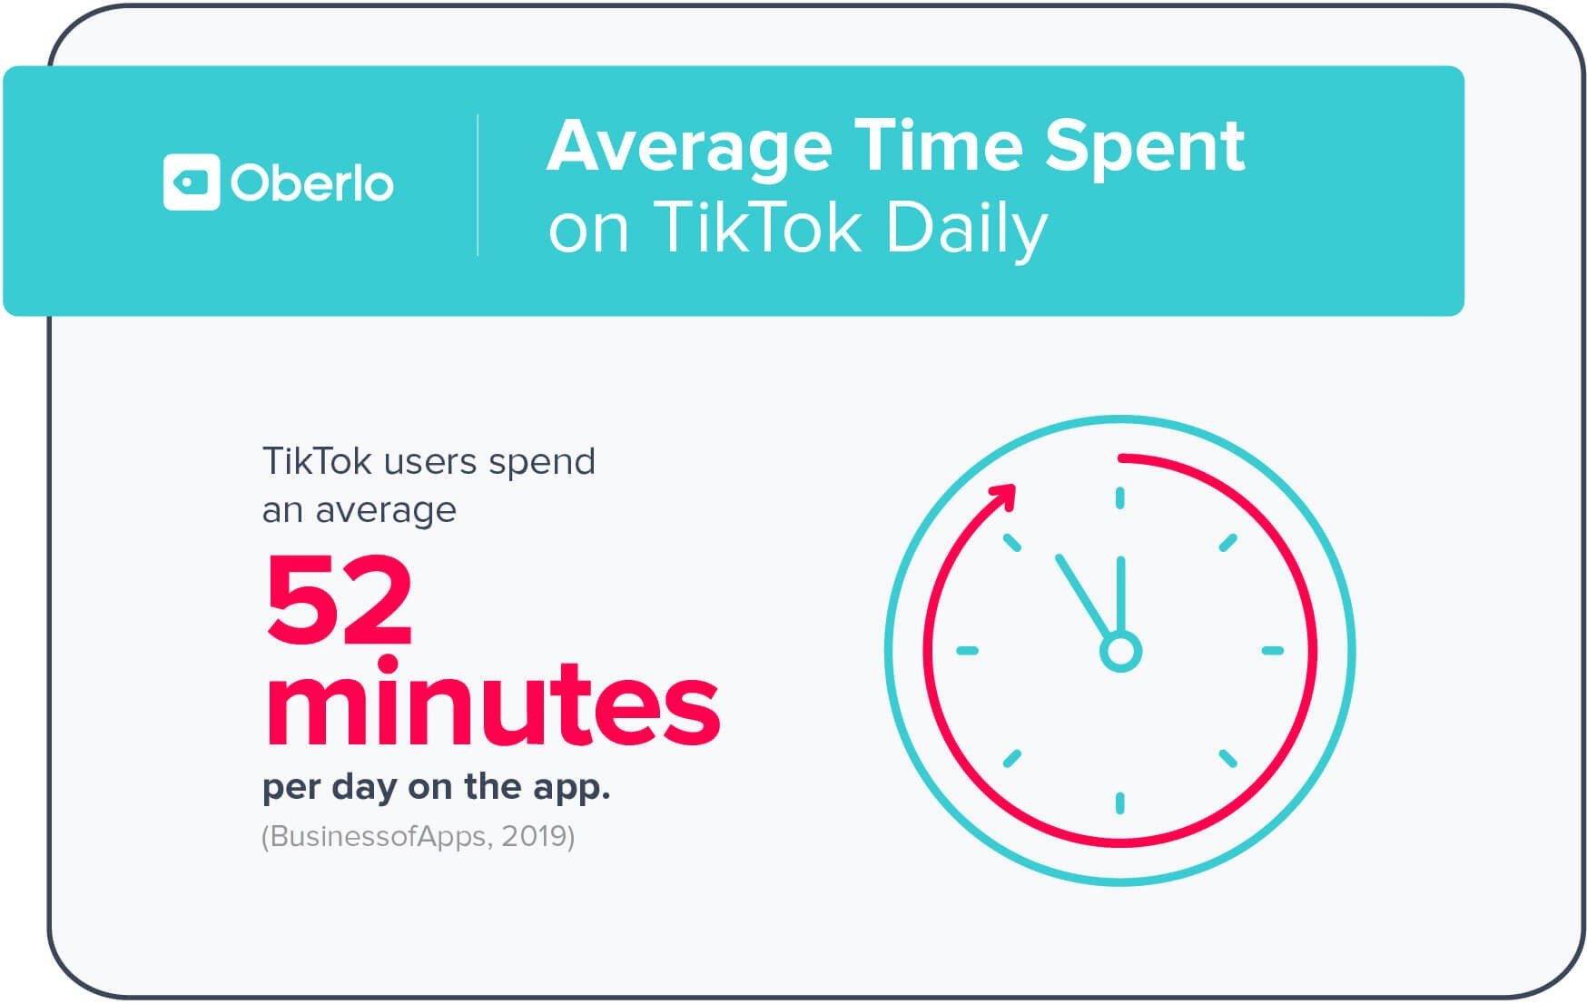
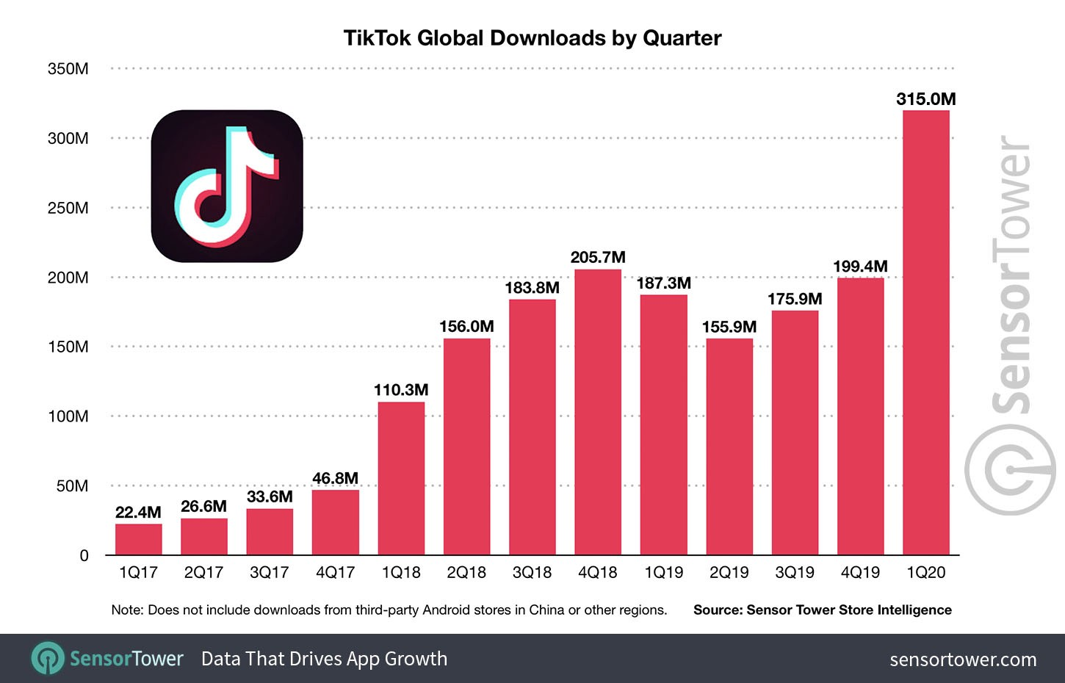
TikTok Key Performance At A Glance

Slide 5
Before The Rise Of TikTok
Vine, a short form video tool which was bought by Twitter in 2012
For USD30M was discontinued in Oct’2016
Snapchat, popular for its short, temporary videos and augmented reality, lost many of video creators due to it’s controversial redesign in 2018
Facebook launched it’s own short format video, Lasso in 2018 with only 70K user downloaded as compare to TikTok’s 4 Million in the same period

Slide 6
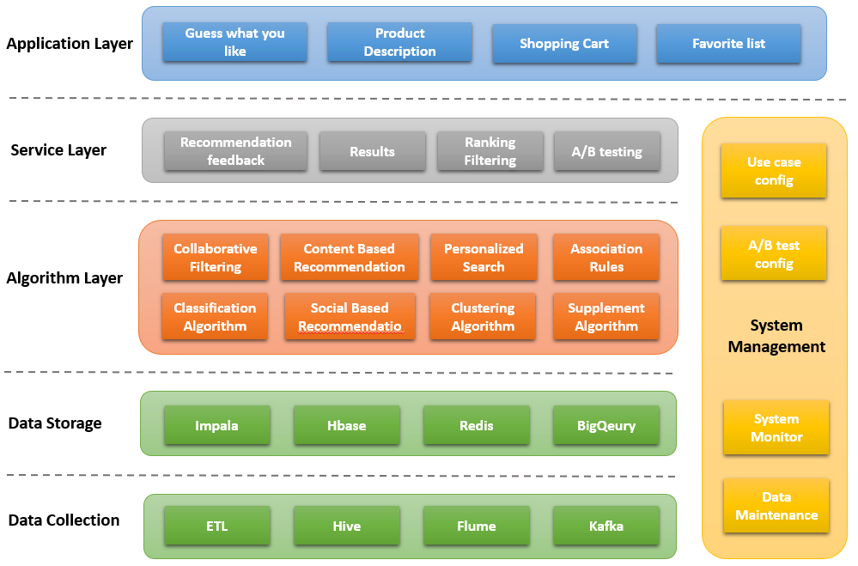
Why TikTok Makes It’s User So Obsessive
Equipped with one of the best Recommending Engine in the industry

Slide 7
Why Did TikTok Succeed?
Not just a social media, is the ability to go viral
Maximizing reach by growing a massive fan base through subscribers and followers
Providing Generation Z a visible place to be themselves
It takes you straight to the app’s content when you open it which hooks the audience straight away, a strategy that appealed to Gen Z audience.
Advanced AI Algorithms to learn user preferences
The most followed TikTok user Charli D’Amelio has been able to work with many brands and companies from her success on the platform
A good platform for users to create content not just for fun but monetary gain.

Slide 8
Pitfalls Of TikTok
Addiction : The app boasts an endless stream of material, students can get hook to it
Bullying : Students make fun of each other’s videos and make videos to ridicule their fellow students
Comparison : Some students make outrageous, dangerous videos just to get more likes and followers, some challenges maybe inappropriate for teens
Safety Concern: Can be used by predators to solicit minors
Bad Content : App may have harmful content promoting self harm or eating disorders

Slide 9
Conclusion
Despite its rapid growth, TikTok hasn't developed a strong source of
revenue. TikTok has a lot of venture-capital backing, but it will have to
generate a profit eventually, which could mean ads or paywalled features.
But if TikTok wants to continue growing at its current rate, it's going to have
to find a way to gain the public's trust outside of China.

Slide 10


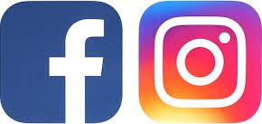
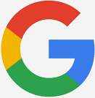
One More Thing……
As the famous Japanese idioms says :
“The nail that sticks out gets hammered down.”
Attracts US ban threatening, critized for censorship, privacy, child safety,national security issues etc…..

Slide 11
Thank You

Slide 12
References
TikTok - Wikipedia
TikTok Business Model: The Rise Of Creative Social Media Powered By AI - FourWeekMBA
Why TikTok made its user so obsessive? The AI Algorithm that got you hooked. | by Catherine Wang | Towards Data Science
What is Tik Tok? Why is it so Popular? | Brandastic
Why Snapchat Is Failing Its Creative Community (forbes.com)
Your IGTV video failed to upload. Instagram. I tried it 10 times and it keeps failing. The video is 40 minutes. Does anybody know what to Do? - Quora
TikTok: Why The Enormous Success? (forbes.com)
The Strategy Behind TikTok’s Global Rise (hbr.org)
The Negative Impact of TikTok on Teens - Smart Social
Tech expert breaks down some of the biggest issues facing TikTok - Business Insider

